Slide 1
Introduction to Database Management Systems
Storing data in traditional text or binary files has its limits
  well suited for applications that store only a small amount of data
  not practical for applications that must store a large amount of data
  simple operations become cumbersome and inefficient as data increases

Slide 2
Introduction to Database Management Systems
A database management system (DBMS) is software that is specifically designed to work with large amounts of data in an efficient and organized manner
  Data is stored using the database management system
  Applications written in Java or other languages communicate with the DBMS rather than manipulate the data directly
  DBMS carries out instructions and sends the results back to the application

Slide 3
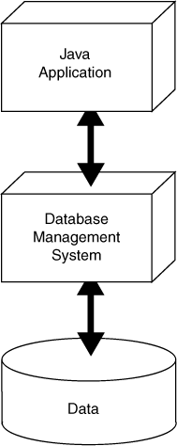
A Java Application Interacts with a DBMS, Which Manipulates Data
The Application sends a command to the DBMS
The Application displays the result to the user
The DBMS executes the command on the Data
The DBMS sends the result back to the Application

Slide 4
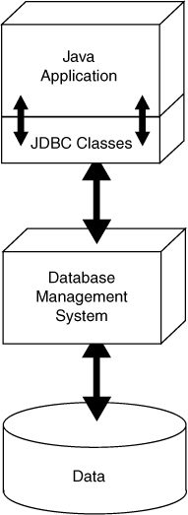
JDBC Provides Connectivity to the DBMS
JDBC stands for Java database connectivity
It is the technology that makes communication possible between the Java application and DBMS
The Java API contains numerous JDBC classes that allow your Java applications to interact with a DBMS

Slide 5
SQL Sends Commands to the DBMS
SQL stands for structured query language
A standard language for working with database management systems
Not used as a general programming language
Consists of several key words, used to construct statements known as queries
Statements or queries are strings passed from the application to the DBMS using API method calls
Serve as instructions for the DBMS to carry out operations on its data

Slide 6
JDBC Needs a DBMS
To use JDBC to work with a database you will need a DBMS
  Apache Derby
  Oracle
  Microsoft SQL Server
  PostgreSQL
  MySQL
  SQLite
The examples in this chapter were created with Apache Derby
  See Appendix K for installation instructions

Slide 7
JDBC Classes
Java comes with a standard set of JDBC classes
  java.sql and javax.sql
Using JDBC in a Java application requires the following steps
  Get a connection to the database
  Pass a string containing an SQL statement to the DBMS
  If the SQL statement has results to send back, they will be sent back as a result set
  When finished working with the database , close the connection

Slide 8
Getting a Database Connection
DriverManager.getConnection(DatabaseURL);
DriverManager.getConnection(DatabaseURL,
Username,
Password);
The static DriverManager.getConnection method is used to get a connection to the database
  The DriverManager class is in the java.sql package
  General format of the simplest version:
  General format if a user name and a password are required:
    Username is a string containing a valid username
    Password is a string containing a password
    DatabaseURL lists the protocol used to access the database

Slide 9
Getting a Database Connection
protocol:subprotocol:databaseName
jdbc:derby:CoffeeDB
DatabaseURL is a string known as a database URL
  URL stands for uniform resource locator
A simple database URL has the following general format:
  protocol is the database protocol
    value is jdbc when using JDBC
  subprotocol varies depending on the type of DBMS
    value is derby when using Apache Derby
  databaseName is the name of the database
Using Apache Derby, the URL for the CoffeeDB database is:

Slide 10
Getting a Database Connection
Final String DB_URL = "jdbc:derby:CoffeeDB";
Connection conn = DriverManager.getConnection(DB_URL);
The DriverManager.getConnection method
  Searches for and loads a compatible JDBC driver for the database specified by the URL
  Returns a reference to a Connection object
    Should be saved in a variable, so it can be used later
  Throws an SQLException if it fails to load a compatible JDBC driver

Slide 11
Getting a Database Connection
conn.close();
try (Connection conn = DriverManager.getConnection(DB_URL))
{
// Statements that work with the database connection…
}
catch(Exception e)
{
System.out.println(e.getMessage());
}
When you are finished using the Connection object, close it by calling its close() method
The Connection class is AutoCloseable, so you can use the try-with-resources statement to open and close Connection objects

Slide 12
Tables, Rows, and Columns
A database management system stores data in a database
A database is organized into one or more tables
Each table holds a collection of related data, organized into rows and columns
A row is a complete set of information about a single item, divided into columns
Each column is an individual piece of information about the item

Slide 13
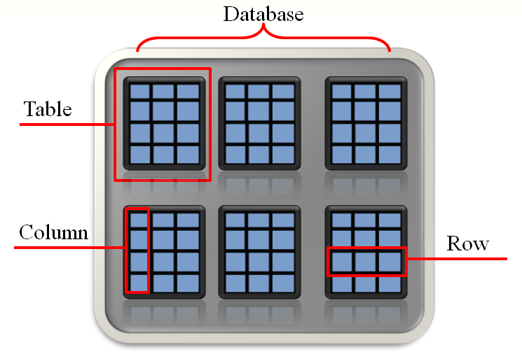
Database Organization

Slide 14
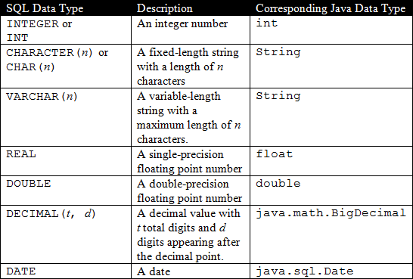
Column Data Types
Columns in a database are assigned an SQL data type
  SQL data types are generally compatible with Java data types

Slide 15
Primary Keys
A primary key is a column that holds a unique value for each row in a database table
In the Coffee table, ProdNum is the primary key
  Each type of coffee has a unique product number
  Used to identify any coffee stored in the table
A primary key can be the combination of several columns in a table

Slide 16
Introduction to the SQL SELECT Statement
SELECT Columns FROM Table
SELECT Description FROM Coffee
SELECT Description, Price FROM Coffee
SELECT * FROM Coffee
The SELECT statement is used to retrieve the rows in a table
  Columns is one or more column names
  Table is a table name
Example 1:
Example 2:
  Multiple column names are separated with a comma
Example 3:
  The * character can be used to retrieve all columns in the table

Slide 17
More About SQL Statements
The following statements all work the same:
SELECT * FROM Coffee
SELECT
*
FROM
Coffee
select * from coffee
SQL statements are free form
  tabs, new lines, and spaces between key words are ignored
SQL key words and table names are case insensitive
Example:

Slide 18
Passing an SQL Statement to the DBMS
The process can be summarized as:
Get a connection to the database.
Create a Statement object and use it to pass an SQL statement, as a string, to the DBMS. If the SQL statement has results to send back, a ResultSet object will be returned to the program.
Process the contents of the ResultSet object, if one has been returned to the program.
Close the ResultSet, Statement, and Connection objects.

Slide 19
Passing an SQL Statement to the DBMS
Simple Example:
Connection conn = DriverManager.getConnection(DB_URL);
Statement stmt = conn.createStatement();
String sqlStatement = "SELECT Description FROM Coffee";
ResultSet result = stmt.executeQuery(sqlStatement);
// Statements that work with the ResultSet
result.close();
stmt.close();
conn.close();

Slide 20
Passing an SQL Statement to the DBMS
Example using try-with-resources:
try (Connection conn = DriverManager.getConnection(DB_URL);
Statement stmt = conn.createStatement();
ResultSet result = stmt.executeQuery(sql))
{
// Statements that work with the ResultSet…
}
catch(SQLException e)
{
System.out.println(e.getMessage());
}

Slide 21
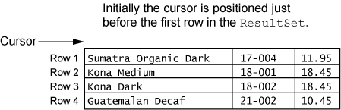
Getting a Row from the ResultSet Object
A ResultSet object has an internal cursor
  Points to a specific row in the ResultSet
  The row to which it points is the current row
  Initially positioned just before the first row
  Can be moved from row to row to examine all rows

Slide 22
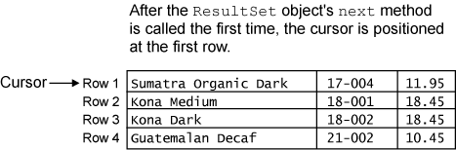
Getting a Row from the ResultSet Object
result.next();
  A ResultSet object’s next method moves the cursor to the next row in the ResultSet
  moves to first row in a newly created ResultSet
  moves to the next row each time it is called

Slide 23
Getting a Row from the ResultSet Object
while (result.next())
{
// Process the current row.
}
A ResultSet object’s next method returns a Boolean value
  true if successfully moved to the next row
  false if there are no more rows
A while loop can be used to move through all the rows of a newly created ResultSet

Slide 24
Getting Columns in a ResultSet Object
System.out.println(result.getString(1));
System.out.println(result.getString(1));
System.out.println(result.getString(1));
System.out.println(result.getString("Description"));
System.out.println(result.getString("ProdNum"));
System.out.println(result.getDouble("Price"));
Examples: ShowCoffeeDescriptions.java
ShowDescriptionsAndPrices.java
You use one of the ResultSet object’s “get” methods to retrieve the contents of a specific column in the current row.
Can pass an argument for either the column number or the column name

Slide 25
Getting Columns in a ResultSet Object
ResultSet Method | Description
double getDouble(int colNumber) double getDouble(String colName) | Returns the double that is stored in the column specified by colNumber or colName. The column must hold data that is compatible with the double data type in Java. If an error occurs, the method throws an SQLException.
int getInt(int colNumber) int getInt(String colName) | Returns the int that is stored in the column specified by colNumber or colName. The column must hold data that is compatible with the int data type in Java. If an error occurs, the method throws an SQLException.
String getString(int colNumber) String getString(String colName) | Returns the string that is stored in the column specified by colNumber or colName. The column must hold data that is compatible with the String type in Java. If an error occurs, the method throws an SQLException.

Slide 26

Specifying Search Criteria with the WHERE clause
SELECT Columns FROM Table WHERE Criteria
SELECT * FROM Coffee WHERE Price > 12.00
The WHERE clause can be used with the SELECT statement to specify a search criteria
  Criteria is a conditional expression
Example:
Only the rows that meet the search criteria are returned in the result set
A result set is an object that contains the results of an SQL statement

Slide 27
SQL Relational Operators
Operator | Meaning
> | Greater than
< | Less than
>= | Greater than or equal to
<= | Less than or equal to
= | Equal to
<> | Not equal to
Example: PriceMoreThan10.java
Standard SQL supports the following relational operators:
Notice a few SQL relational operators are different than in Java
  SQL equal to operator is =
  SQL not equal to operator is <>

Slide 28
String Comparisons in SQL
SELECT * FROM Coffee WHERE Description = 'French Roast Dark'
SELECT * FROM Coffee WHERE Description = 'french roast dark'
SELECT * FROM Coffee
WHERE UPPER(Description) = 'FRENCH ROAST DARK'
SELECT * FROM Coffee WHERE Description ='Joe''s Special Blend'
Example 1:
  In SQL, strings are enclosed in single quotes
Warning!
  String comparisons in SQL are case sensitive
Example 2:
  The UPPER() or LOWER() functions convert the string to uppercase or lowercase and can help prevent case sensitive errors when comparing strings
Example 3:
  If a single quote (') is part of a string, use two single quotes ('')

Slide 29
Using the LIKE Operator
SELECT * FROM Coffee WHERE Description LIKE '%Decaf%'
SELECT * FROM Coffee WHERE ProdNum LIKE '2_-00_'
SELECT * FROM Coffee
WHERE Description NOT LIKE '%Decaf%'
In SQL, the LIKE operator can be used to search for a substring
Example 1:
  The % symbol is used as a wildcard for multiple characters
Example 2:
  The underscore (_) is a used as a wildcard for a single character
Example 3:
  The NOT operator is used to disqualify the search criteria

Slide 30
Using AND and OR
SELECT * FROM Coffee
WHERE Price > 10.00 AND Price < 14.00
SELECT * FROM Coffee
WHERE Description LIKE '%Dark%' OR ProdNum LIKE '16%'
The AND and OR operators can be used to specify multiple search criteria in a WHERE clause
Example 1:
  The AND operator requires that both search criteria be true
Example 2:
  The OR operator requires that either search criteria be true

Slide 31
Sorting the Results of a SELECT Query
SELECT * FROM Coffee ORDER BY Price
SELECT * FROM Coffee
WHERE Price > 9.95 ORDER BY Price DESC
Use the ORDER BY clause to sort results according to a column value
Example 1:
  Sorted in ascending order (ASC) by default
Example 2:
  Use the DESC operator to sort results in descending order

Slide 32
Mathematical Functions
Example: CoffeeMath.java
SELECT AVG(Price) FROM Coffee
SELECT SUM(Price) FROM Coffee
SELECT MIN(Price) FROM Coffee
SELECT MAX(Price) FROM Coffee
SELECT COUNT(*) FROM Coffee
The AVG function
  calculates the average value in a particular column
The SUM function
  calculates the sum of a column’s values
The MIN and MAX functions
  calculate the minimum and maximum values found in a column
The COUNT function
  can be used to determine the number of rows in a table

Slide 33
Parameterized Queries
String sql = "SELECT * FROM Coffee WHERE Price > ? AND Price < ?"
A parameterized query allows you to insert one or more values, at runtime, into the text of an SQL statement.
Example:
The question marks are placeholders for values that will be inserted into the query

Slide 34
Parameterized Queries
String sql = "SELECT * FROM Coffee WHERE Price > ? AND Price < ?"
PreparedStatement stmt = conn.prepareStatement(sql);
To execute a parameterized query, you create a PreparedStatement object instead of a Statement object.
PreparedStatement is an interface in the java.sql package.
To get a PreparedStatement object for your database, you call the Connection object's prepareStatement method.
Example:

Slide 35
Parameterized Queries
You can use the PreparedStatement object's set methods to provide values for the placeholders in the SQL statement.
void setInt(int placeholderPosition, int value) Replaces the specified placeholder with the int specified by value.
void setDouble(int placeholderPosition, double value) Replaces the specified placeholder with the double specified by value.
void setFloat(int placeholderPosition, float value) Replaces the specified placeholder with the float specified by value.
void setString(int placeholderPosition, String value) Replaces the specified placeholder with the String specified by value.
void setDate(int placeholderPosition, Date value) Replaces the specified placeholder with the Date specified by value.
void setBigDecimal(int placeholderPosition, BigDecimal value) Replaces the specified placeholder with the BigDecimal specified by value.

Slide 36
Parameterized Queries
Example:
The resulting SQL query becomes:
String sql = "SELECT * FROM Coffee WHERE Price > ? AND Price < ?"
PreparedStatement stmt = conn.prepareStatement(sql);
stmt.setDouble(1, 10.0);
stmt.setDouble(2, 15.0);
SELECT * FROM Coffee WHERE Price > 10.0 AND Price < 15.0

Slide 37
Parameterized Queries
To execute the parameterized query, you call the PreparedStatement object's executeQuery method, as shown here:
The executeQuery method returns a reference to a ResultSet object containing the results of the parameterized query.
If the executeQuery method encounters a database error, it will throw an SQLException.
String sql = "SELECT * FROM Coffee WHERE Price > ? AND Price < ?"
PreparedStatement stmt = conn.prepareStatement(sql);
stmt.setDouble(1, 10.0);
stmt.setDouble(2, 15.0);
ResultSet result = stmt.executeQuery();

Slide 38
Parameterized Queries
PreparedStatement objects are resources that should be closed when you are finished using them.
You can explicitly close a PreparedStatement object by calling its close method, or you can let the try-with-resources statement automatically close it.
See examples
  MinMaxPrices.java
  ProdNumSearch.java
  PartialProdNumSearch.java

Slide 39
Inserting Rows
INSERT INTO TableName VALUES (Value1, Value2, ...)
INSERT INTO Coffee
VALUES ('Honduran Dark', '22-001', 8.65)
Description: Honduran Dark
ProdNum: 22-001
Price: 8.65
In SQL, the INSERT statement inserts a row into a table
  TableName is the name of the database table
  Value1, Value2, ... is a list of column values
Example:
  Strings are enclosed in single quotes
  Values appear in the same order as the columns in the table
Inserts a new row with the following column values:

Slide 40
Inserting Rows
INSERT INTO TableName
(ColumnName1, ColumnName2, ...)
VALUES
(Value1, Value2, ...)
INSERT INTO Coffee
(ProdNum, Price, Description)
VALUES
('22-001', 8.65, 'Honduran Dark')
If column order is uncertain, the following general format can be used
  ColumnName1, ColumnName2, ... is a list of column names
  Value1, Value2, ... is a list of corresponding column values
Example:
Keep in mind that primary key values must be unique
For example, a duplicate ProdNum is not allowed in the Coffee table

Slide 41
Inserting Rows with JDBC
To issue an INSERT statement, you must get a reference to a Statement object
  The Statement object has an executeUpdate method
  Accepts a string containing the SQL INSERT statement as an argument
  Returns an int value for the number of rows inserted
Example:
rows should contain the value 1, indicating that one row was inserted
String sqlStatement = "INSERT INTO Coffee " +
"(ProdNum, Price, Description)" +
" VALUES " +
"('22-001', 8.65, 'Honduran Dark')";
int rows = stmt.executeUpdate(sqlStatement);

Slide 42
Inserting Rows with JDBC
INSERT statements can be parameterized
Example:
String sql = "INSERT INTO Coffee " +
"(ProdNum, Price, Description) " +
"VALUES (?, ?, ?)";
String pnum = "22-001";
double price = 8.65;
String desc = "Honduran Dark";
PreparedStatement stmt = conn.prepareStatement(sql);
stmt.setString(1, pnum);
stmt.setDouble(2, price);
stmt.setString(3, desc);
int rows = stmt.executeUpdate();
Example: CoffeeInserter.java

Slide 43
Updating an Existing Row
UPDATE Table
SET Column = Value
WHERE Criteria
UPDATE Coffee
SET Price = 9.95
WHERE Description = 'Galapagos Organic Medium'
In SQL, the UPDATE statement changes the contents of an existing row in a table
  Table is a table name
  Column is a column name
  Value is the value to store in the column
  Criteria is a conditional expression
Example:

Slide 44
Updating More Than One Row
UPDATE Coffee
SET Price = 12.95
WHERE ProdNum LIKE '21%'
UPDATE Coffee
SET Price = 4.95
It is possible to update more than one row
Example:
  Updates the price of all rows where the product number begins with 21
Warning!
  Because this statement does not have a WHERE clause, it will change the price for every row

Slide 45
Updating Rows with JDBC
To issue an UPDATE statement, you must get a reference to a Statement object
  The Statement object has an executeUpdate method
  Accepts a string containing the SQL UPDATE statement as an argument
  Returns an int value for the number of rows affected
Example:
rows indicates the number of rows that were changed
String sqlStatement = "UPDATE Coffee " +
"SET Price = 9.95" +
" WHERE " +
"Description = 'Brazilian Decaf'";
int rows = stmt.executeUpdate(sqlStatement);
Example: UpdateProductNum.java

Slide 46
Updating Rows with JDBC
UPDATE statements can be parameterized
Example:
String sql = "UPDATE Coffee " +
"SET Price = ? " +
"WHERE ProdNum = ?";
String pnum = "14-001";
double price = 9.95;
PreparedStatement stmt = conn.prepareStatement(sql);
stmt.setDouble(1, price);
stmt.setString(2, pnum);
int rows = stmt.executeUpdate();
Example: PriceUpdater.java

Slide 47
Deleting Rows with the DELETE Statement
DELETE FROM Table WHERE Criteria
DELETE FROM Coffee WHERE ProdNum = '20-001'
DELETE FROM Coffee WHERE Description LIKE 'Sumatra%'
DELETE FROM Coffee
In SQL, the DELETE statement deletes one or more rows in a table
  Table is the table name
  Criteria is a conditional expression
Example 1:
  Deletes a single row in the Coffee table where the product number is 20-001
Example 2:
  Deletes all rows in the Coffee table where the description begins with Sumatra
Warning!
  Because this statement does not have a WHERE clause, it will delete every row in the Coffee table

Slide 48
Deleting Rows with JDBC
To issue a DELETE statement, you must get a reference to a Statement object
  The Statement object has an executeUpdate method
  Accepts a string containing the SQL DELETE statement as an argument
  Returns an int value for the number of rows that were deleted
Example:
rows indicates the number of rows that were deleted
String sqlStatement = "DELETE FROM Coffee " +
"WHERE ProdNum = '20-001'";
int rows = stmt.executeUpdate(sqlStatement);
Example: DeleteRow.java

Slide 49
Deleting Rows with JDBC
DELETE statements can be parameterized
Example:
String sql = "DELETE FROM Coffee " +
"WHERE ProdNum = ?";
String pnum = "22-002";
PreparedStatement stmt = conn.prepareStatement(sql);
stmt.setString(1, pnum);
int rows = stmt.executeUpdate();
Example: CoffeeDeleter.java

Slide 50
Creating Tables with the CREATE TABLE Statement
CREATE TABLE TableName
(ColumnName1 DataType1,
ColumnName2 DataType2, ...)
CREATE TABLE Customer
( Name CHAR(25), Address CHAR(25),
City CHAR(12), State CHAR(2), Zip CHAR(5) )
In SQL, the CREATE TABLE statement adds a new table to the database
  TableName is the name of the table
  ColumnName1 is the name of the first column
  DataType1 is the SQL data type for the first column
  ColumnName2 is the name of the second column
  DataType2 is the SQL data type for the second column
Example:
  Creates a new table named Customer with the columns Name, Address, City, State, and Zip

Slide 51
Creating Tables with the CREATE TABLE Statement
CREATE TABLE Customer
( CustomerNumber CHAR(10) NOT NULL PRIMARY KEY
Name CHAR(25), Address CHAR(25),
City CHAR(12), State CHAR(2), Zip CHAR(5) )
The PRIMARY KEY qualifier is used to specify a column as the primary key
The NOT NULL qualifier is used to specify that the column must contain a value for every row
  Qualifiers should be listed after the column’s data type
Example: CreateCustomerTable.java
  Creates a new table named Customer with the columns CustomerNumber, which is the primary key, Name, Address, City, State, and Zip

Slide 52
Removing a Table with the DROP TABLE Statement
DROP TABLE TableName
DROP TABLE Customer
In SQL, the DROP TABLE statement deletes an existing table from the database
  TableName is the name of the table you wish to delete
Example:
  Deletes the Customer table from the CoffeeDB database
  Useful if you make a mistake creating a table
  Simply delete the table and recreate

Slide 53
ResultSet Navigation Methods
relative(rows)
  Moves the cursor the number specified by the rows argument relative to the current row
    A positive rows value will move the cursor forward
    A negative rows value will move the cursor backward
absolute(rows)
  Moves the cursor to the row number specified by the rows argument
    A rows value of 1 will move the cursor to the first row
    A rows value of 2 will move cursor to the second row
    And so on until the last row

Slide 54
Determining the Number of Rows in a Result Set
resultSet.last() // Move to the last row
int numRows = resultSet.getRow(); // Get the current row number
resultSet.first(); // Move back to the first row
ResultSet navigation methods can be used to determine the number of rows in a result set
Example:
  Move cursor to last row
  Get the last row’s number and store the value
  Move back to the first row

Slide 55
Relational Data
UnpaidOrder table:
CustomerNumber CHAR(10) Foreign Key
ProdNum CHAR(10) Foreign Key
OrderDate CHAR(10)
Quantity DOUBLE
Cost DOUBLE
A foreign key is a column in one table that references a primary key in another table
  Creates a relationship between the tables
Example:
  The CustomerNumber column references the Customer table
  The ProdNum column references the Coffee table
  This creates a relationship between the tables of the CoffeeDB database

Slide 56
Creating the UnpaidOrder Table
CREATE TABLE UnpaidOrder
( CustomerNumber CHAR(10) NOT NULL
REFERENCES Customer(CustomerNumber),
ProdNum CHAR(10) NOT NULL
REFERENCES Coffee(ProdNum),
OrderDate CHAR(10),
Quantity DOUBLE,
Cost DOUBLE )
The following SQL statement creates the UnpaidOrder table in the CoffeeDB database:
The REFERENCES qualifier ensures referential integrity between tables
  The CustomerNumber in the UnpaidOrder table must contain a valid CustomerNumber from the Customer table
  The ProdNum in the UnpaidOrder table must contain a valid ProdNum from the Coffee table

Slide 57
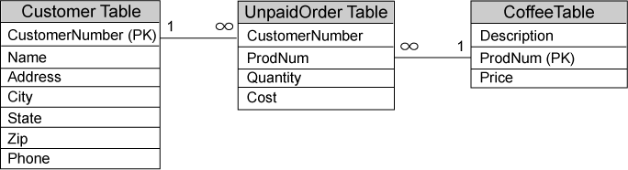
Entity Relationship Diagrams
An entity relationship diagram shows the relationships between tables
Primary keys are denoted with (PK)
Lines drawn between tables show how they are related
  The ends of each line show either a 1 or an infinity symbol (∞)
    The infinity symbol means many and number 1 means one.
  A one to many relationship means that for each row in table A there can be many rows in table B that reference it.
  A many to one relationship means that many rows in table A can reference a single row in table B.

Slide 58
CoffeeDB Relationships Left to Right
One to many relationship between Customer and UnpaidOrder
  One row in the Customer table may be referenced by many rows in the UnpaidOrder table
Many to one relationship between the UnpaidOrder and Coffee tables
  Many rows in the UnpaidOrder table may reference a single row in the Coffee table.

Slide 59
CoffeeDB Relationships Right to Left
One to many relationship between Coffee and UnpaidOrder
  One row in the Coffee table may be referenced by many rows in the UnpaidOrder table
Many to one relationship between UnpaidOrder and Customer
  Many rows in the UnpaidOrder table may reference a single row in the Customer table.

